Slide 1
General Tree Search

Slide 2
General Tree Search
Main variations:
Which leaf node to expand next
Whether to check for repeated states
Data structures for frontier, expanded nodes

Slide 3

Depth-First Search

Slide 4
Depth-First Search
Strategy: expand a deepest node first
Implementation: Frontier is a LIFO stack
a
G
b
c
d
e
f
S
h
p
q
r
S
d
e
p
b
c
e
h
r
q
a
a
h
r
p
q
f
p
q
f
q
c
G
q
c
G
a
a

Slide 5
Depth-First Search
Strategy: expand a deepest node first
Implementation: Frontier is a LIFO stack
a
G
b
c
d
e
f
S
h
p
q
r
S
d
e
p
b
c
e
h
r
q
a
a
h
r
p
q
f
p
q
f
q
c
G
q
c
G
a
a

Slide 6
Depth-First Search
Strategy: expand a deepest node first
Implementation: Frontier is a LIFO stack
a
G
a
c
b
c
b
e
d
e
d
f
f
S
h
h
p
p
r
q
r
q
S
d
e
p
b
c
e
h
r
q
a
a
h
r
p
q
f
p
q
f
q
c
G
q
c
G
a
a

Slide 7
Search Algorithm Properties
Complete: Guaranteed to find a solution if one exists?
Optimal: Guaranteed to find the least cost path?
Time complexity?
Space complexity?
Cartoon of search tree:
b is the branching factor
m is the maximum depth
solutions at various depths
Number of nodes in entire tree?
1 + b + b² + …. b^{m} = O(b^{m})
1 node
b
…
b nodes
b² nodes
m tiers
b^{m} nodes

Slide 8
Depth-First Search (DFS) Properties
What nodes does DFS expand?
Some left prefix of the tree down to depth m.
Could process the whole tree!
If m is finite, takes time O(b^{m})
How much space does the frontier take?
Only has siblings on path to root, so O(bm)
Is it complete?
m could be infinite
preventing cycles may help (more later)
Is it optimal?
No, it finds the “leftmost” solution, regardless of depth or cost
1 node
b
…
b nodes
b² nodes
m tiers
b^{m} nodes

Slide 9
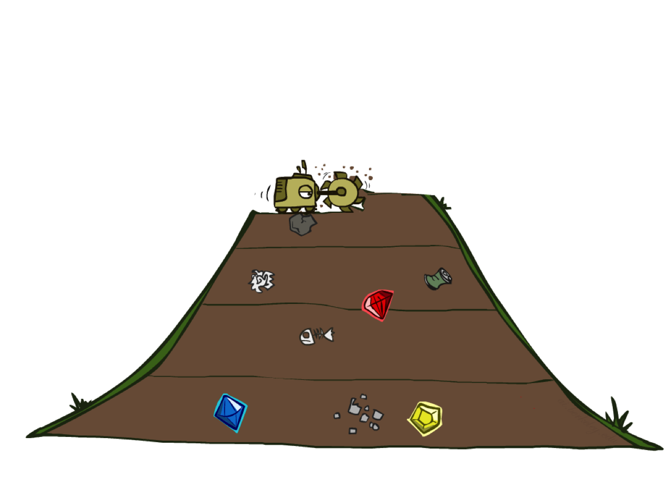
Breadth-First Search

Slide 10
Breadth-First Search
Strategy: expand a shallowest node first
Implementation: Frontier is a FIFO queue
a
G
b
c
d
e
f
S
h
p
q
r
S
d
e
p
b
c
e
h
r
q
a
a
h
r
p
q
f
p
q
f
q
c
G
q
c
G
a
a

Slide 11
Breadth-First Search
Strategy: expand a shallowest node first
Implementation: Frontier is a FIFO queue
a
G
b
c
d
e
f
S
h
p
q
r
S
d
e
p
Search
Tiers
b
c
e
h
r
q
a
a
h
r
p
q
f
p
q
f
q
c
G
q
c
G
a
a

Slide 12
Breadth-First Search (BFS) Properties
What nodes does BFS expand?
Processes all nodes above shallowest solution
Let depth of shallowest solution be s
Search takes time O(b^{s})
How much space does the frontier take?
Has roughly the last tier, so O(b^{s})
Is it complete?
s must be finite if a solution exists, so yes!
Is it optimal?
If costs are equal (e.g., 1)
1 node
b
…
b nodes
s tiers
b² nodes
b^{s} nodes
b^{m} nodes

Slide 13
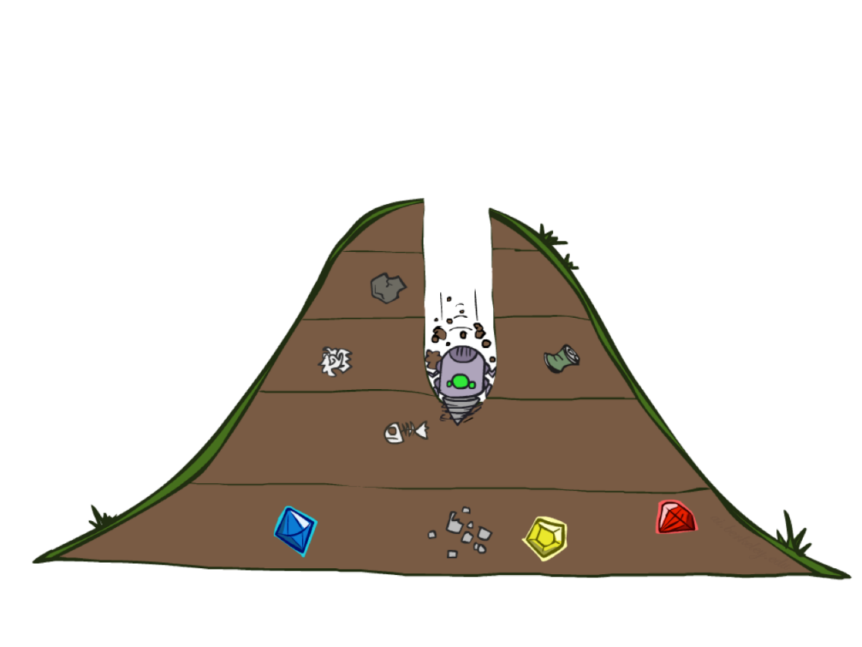
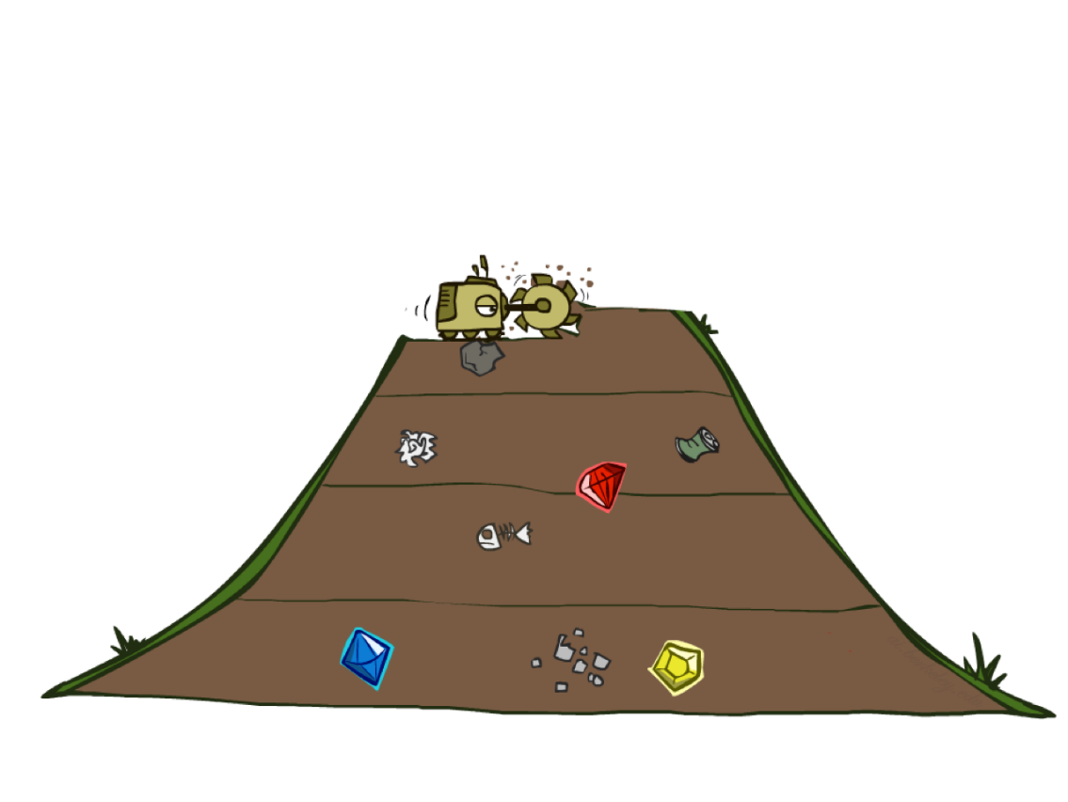
Quiz: DFS vs BFS

Slide 14
Quiz: DFS vs BFS
When will BFS outperform DFS?
When will DFS outperform BFS?
[Demo: dfs/bfs maze water (L2D6)]
Notes:
BFS best when there is a shallow solution, s << m
DFS best when solutions all at m, and fairly common at m

Slide 15

Example: Maze Water DFS/BFS (part 1)
Notes:
This is breadth-first – spreads out in concentric circles from root. Explores a lot of the state space

Slide 16
Example: Maze Water DFS/BFS (part 2)
Notes:
This is DFS – explores less but finds a terrible solution.
Is it checking for repeated states? Yes! (Otherwise it would never complete)

Slide 17
Iterative Deepening
Idea: get DFS’s space advantage with BFS’s time / shallow-solution advantages
Run a DFS with depth limit 1. If no solution…
Run a DFS with depth limit 2. If no solution…
Run a DFS with depth limit 3. …..
Isn’t that wastefully redundant?
Generally most of the work happens in the lowest level searched, so it’s not so bad!
Extra work is O(b^{s-1})
b
…
Notes:
1 + (1+b) + (1+b+b²) + … + (1+b+…+b^{s}) = (s+1) + sb + (s-1)b² + … + b^{s} = O(b^{s})

Slide 18

Uniform Cost Search

Slide 19
Uniform Cost Search
2
G
a
g(n) = cost from root to n
Strategy: expand lowest g(n)
Frontier is a priority queue sorted by g(n)
b
c
1
8
2
2
e
3
d
f
9
8
2
S
h
1
1
p
q
r
15
0
S
d
3
e
9
p
1
b
4
e
5
h
17
r
11
q
16
c
11
Cost contours
a
6
a
h
13
r
7
p
q
f
p
q
f
8
q
c
G
q
c
a
11
G
10
a

Slide 20
Uniform Cost Search (UCS) Properties
What nodes does UCS expand?
Expands all nodes with cost less than cheapest solution!
If that solution costs C* and arcs cost at least  , then the “effective depth” is roughly C*/
Takes time O(b^{C*/}) (exponential in effective depth)
How much space does the frontier take?
Has roughly the last tier, so O(b^{C*/})
Is it complete?
Assuming C* is finite and  > 0, yes!
Is it optimal?
Yes! (Proof next lecture via A*)
b
g  1
…
C*/ “tiers”
g  2
g  3

Slide 21
Video of Demo Maze with Deep/Shallow Water --- BFS or UCS? (part 1)
Notes:
Cost 1 for shallow, 2 for deep water. Let students guess which one of the three it is. (This is BFS.)

Slide 22
Video of Demo Maze with Deep/Shallow Water --- BFS or UCS? (part 2)
Notes:
Let students guess which one of the three it is. (This is UCS.)

Slide 23
Summary
Assume known, discrete, observable, deterministic, atomic
Search problems defined by S, s₀, A(s), Result(s,a), G(s), c(s,a,s’)
Search algorithms find action sequences that reach goal states
Optimal = minimum-cost
Search algorithm properties:
Depth-first: incomplete, suboptimal, space-efficient
Breadth-first: complete, (sub)optimal, space-prohibitive
Iterative deepening: complete, (sub)optimal, space-efficient
Uniform-cost: complete, optimal, space-prohibitive
Notes:
S = state space
s0 = initial state
A(s) = a finite set of actions that can be executed by the agent in state s.
Example: A(Arad) = {ToSibiu, ToTimisoara, ToZerind}
Result(s,a) is the “transition model” which describes what each action does. It returns the state that results from doing action a in state s.
Example: Result(Arad, ToZerind) = Zerind

Slide 24
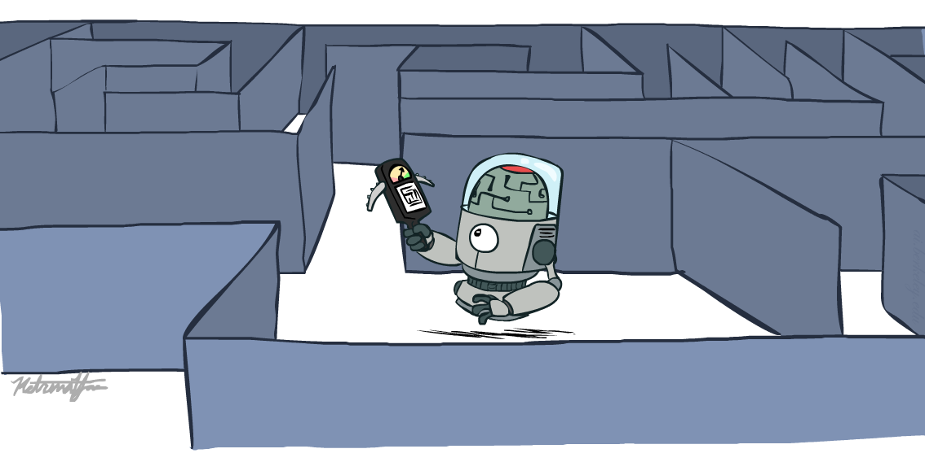
CS 370: Artificial Intelligence
Informed Search
Instructor: William DeMeo
Slides courtesy of Stuart Russell, Dawn Song and ai.berkeley.edu of University of California, Berkeley
Notes:
Please retain proper attribution and the reference to ai.berkeley.edu. Thanks!

Slide 25
Example: route-finding in Romania

Slide 26
What we would like to have happen
Guide search towards the goal instead of all over the place
Start
Goal
Start
Goal
Informed
Uninformed

Slide 27
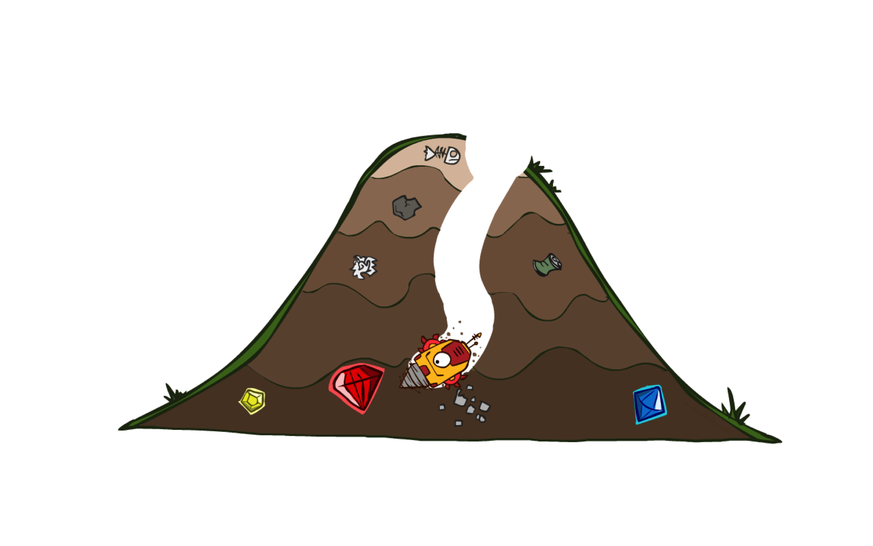
A* Search

Slide 28
A*: the core idea
Expand a node n most likely to be on an optimal path
Expand a node n s.t. the cost of the best solution through n is optimal
Expand a node n with lowest value of g(n) + h*(n)
g(n) is the cost from root to n
h*(n) is the optimal cost from n to the closest goal
We seldom know h*(n) but might have an heuristic approximation to h(n)
A* = tree search with priority queue ordered by f(n) = g(n) + h(n)

Slide 29
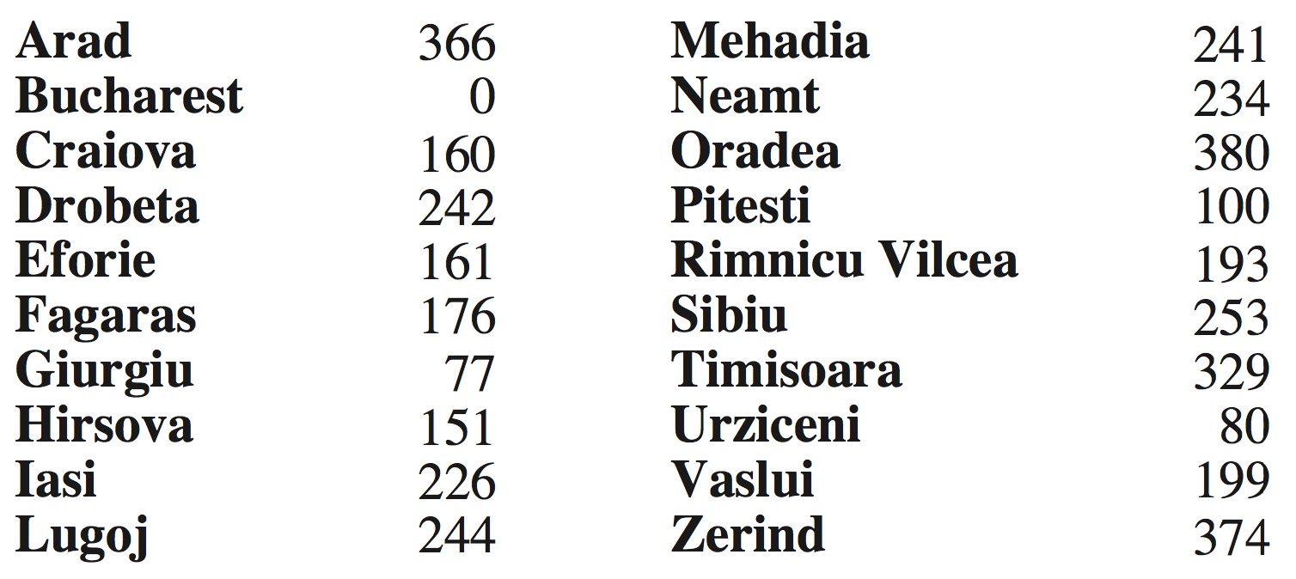
Example: route-finding in Romania
h(n) = straight-line distance to Bucharest

Slide 30



Example: pathing in Pacman
h(n) = Manhattan distance = |x| + |y|
Is Manhattan better than straight-line distance?
10
5
11.2

Slide 31
Is A* Optimal?
h = 6
1
A
3
S
h = 7
G
h = 0
5
What went wrong?
Actual bad solution cost < estimated good solution cost
We need estimates to be less than actual costs!

Slide 32

Admissible Heuristics

Slide 33
Admissible Heuristics
A heuristic h is admissible (optimistic) if:
0  h(n)  h*(n)
where h*(n) is the true cost to a nearest goal
Example:
Finding good, cheap admissible heuristics is the key to success
15

Slide 34

Optimality of A* Tree Search

Slide 35
Optimality of A* Tree Search
Assume:
A is an optimal goal node
B is a suboptimal goal node
h is admissible
Claim:
A will be chosen for expansion before B
…
A
B

Slide 36
Optimality of A* Tree Search: Blocking
Proof:
Imagine B is on the frontier
Some ancestor n of A is on the frontier, too (maybe A itself!)
Claim: n will be expanded before B
f(n)  f(A)
…
n
A
B
f(n) = g(n) + h(n) Definition of f-cost
f(n)  g(A) Admissibility of h
g(A) = f(A) h = 0 at a goal

Slide 37
Optimality of A* Tree Search: Blocking
Proof:
Imagine B is on the frontier
Some ancestor n of A is on the frontier, too (maybe A itself!)
Claim: n will be expanded before B
f(n)  f(A)
f(A) < f(B)
…
n
A
B
g(A) < g(B) Suboptimality of B
f(A) < f(B) h = 0 at a goal

Slide 38
Optimality of A* Tree Search: Blocking
Proof:
Imagine B is on the frontier
Some ancestor n of A is on the frontier, too (maybe A itself!)
Claim: n will be expanded before B
f(n)  f(A)
f(A) < f(B)
n is expanded before B
All ancestors of A are expanded before B
A is expanded before B
A* tree search is optimal
…
n
A
B
f(n)  f(A) < f(B)

Slide 39
UCS vs A* Contours
Uniform-cost expands equally in all “directions”
A* expands mainly toward the goal, but does hedge its bets to ensure optimality
Start
Goal
Start
Goal

Slide 40



Comparison
Greedy (h)
Uniform Cost (g)
A* (g+h)

Slide 41
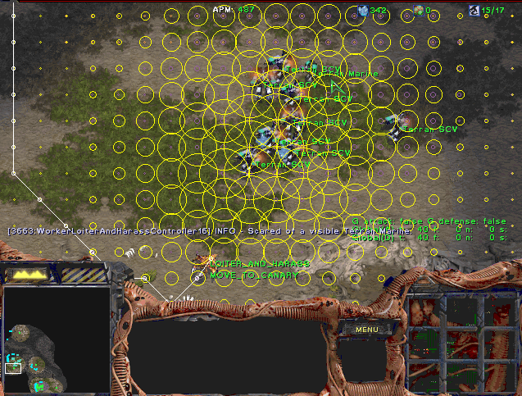
A* Applications
Video games
Pathing / routing problems
Resource planning problems
Robot motion planning
Language analysis
Machine translation
Speech recognition
Protein design
Chemical synthesis
…

Slide 42

Creating Heuristics

Slide 43
Creating Admissible Heuristics
Often, admissible heuristics are solutions to relaxed problems, where new actions are available
Problem P₂ is a relaxed version of P₁ if A₂(s)  A₁(s) for every s
Theorem: h₂*(s)  h₁*(s) for every s, so h₂*(s) is admissible for P₁
15
366

Slide 44

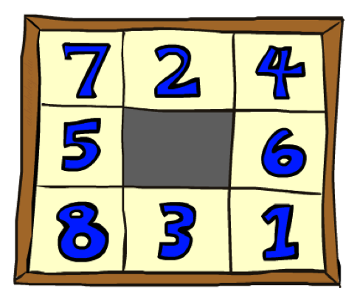
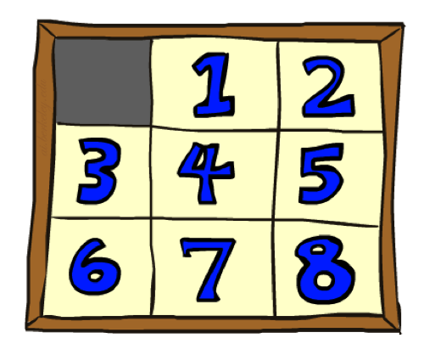
Example: 8 Puzzle
Start State
Actions
Goal State
What are the states?
How many states?
What are the actions?
What are the step costs?
Notes:
9! = 362,880 but 16! (15-puzzle) = 20 trillion, 25! = 10^25

Slide 45
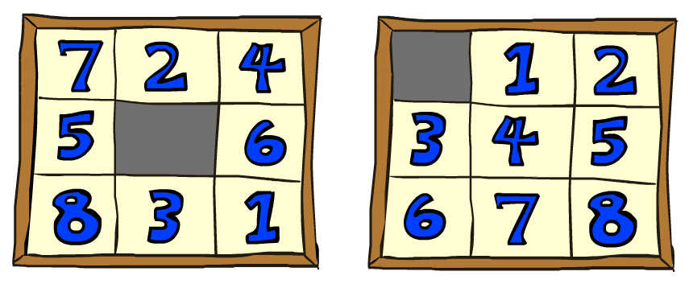

8 Puzzle I
Heuristic: Number of tiles misplaced
Why is it admissible?
h(start) =
8
Start State
Goal State
 | Average nodes expanded when the optimal path has…
 | …4 steps | …8 steps | …12 steps
UCS | 112 | 6,300 | 3.6 x 10⁶
A*TILES | 13 | 39 | 227
Statistics from Andrew Moore

Slide 46
8 Puzzle II
What if we had an easier 8-puzzle where any tile could slide any direction at any time, ignoring other tiles?
Total Manhattan distance
Why is it admissible?
h(start) =
Start State
Goal State
 | Average nodes expanded when the optimal path has…
 | …4 steps | …8 steps | …12 steps
A*TILES | 13 | 39 | 227
A*MANHATTAN | 12 | 25 | 73
3 + 1 + 2 + … = 18

Slide 47
Combining heuristics
Dominance: h₁ ≥ h₂ if
n h₁(n)  h₂(n)
Roughly speaking, larger is better as long as both are admissible
The zero heuristic is pretty bad (what does A* do with h=0?)
The exact heuristic is pretty good, but usually too expensive!
What if we have two heuristics, neither dominates the other?
Form a new heuristic by taking the max of both:
h(n) = max( h₁(n), h₂(n))
Max of admissible heuristics is admissible and dominates both!
Notes:
Semi-lattice: x <= y <-> x = x ^ y

Slide 48

Example: Knight’s moves
Minimum number of knight’s moves to get from A to B?
h₁ = (Manhattan distance)/3
h₁’ = h₁ rounded up to correct parity (even if A, B same color, odd otherwise)
h₂ = (Euclidean distance)/√5 (rounded up to correct parity)
h₃ = (max x or y shift)/2 (rounded up to correct parity)
h(n) = max( h₁’(n), h₂(n), h₃(n)) is admissible!
Notes:
Semi-lattice: x <= y <-> x = x ^ y

Slide 49
Optimality of A* Graph Search
This part is a bit fiddly,
sorry about that

Slide 50
A* Graph Search Gone Wrong?
State space graph
Search tree
h=4
A
S (0+2)
1
h=1
S
1
C
A (1+4)
B (1+1)
h=2
1
2
B
3
C (2+1)
C (3+1)
h=1
G
G (5+0)
G (6+0)
Simple check against expanded set blocks C
h=0
Fancy check allows new C if cheaper than old
but requires recalculating C’s descendants

Slide 51
Consistency of Heuristics
Main idea: estimated heuristic costs ≤ actual costs
Admissibility: heuristic cost ≤ actual cost to goal
h(A) ≤ h*(A)
Consistency: heuristic “arc” cost ≤ actual cost for each arc
h(A) – h(C) ≤ c(A,C)
or h(A) ≤ c(A,C) + h(C) (triangle inequality)
Note: h* necessarily satisfies triangle inequality
Consequences of consistency:
The f value along a path never decreases:
h(A) ≤ c(A,C) + h(C) => g(A) + h(A) ≤ g(A) + c(A,C) + h(C)
A* graph search is optimal
A
1
C
h=4
h=1
h=3
G

Slide 52
Optimality of A* Graph Search
Sketch: consider what A* does with a consistent heuristic:
Fact 1: In tree search, A* expands nodes in increasing total f value (f-contours)
Fact 2: For every state s, nodes that reach s optimally are expanded before nodes that reach s suboptimally
Result: A* graph search is optimal
…
f  1
f  2
f  3

Slide 53
Optimality
Tree search:
A* is optimal if heuristic is admissible
Graph search:
A* optimal if heuristic is consistent
Consistency implies admissibility
Most natural admissible heuristics tend to be consistent, especially if from relaxed problems

Slide 54

But…
A* keeps the entire explored region in memory
=> will run out of space before you get bored waiting for the answer
There are variants that use less memory (Section 3.5.5):
IDA* works like iterative deepening, except it uses an f-limit instead of a depth limit
On each iteration, remember the smallest f-value that exceeds the current limit, use as new limit
Very inefficient when f is real-valued and each node has a unique value
RBFS is a recursive depth-first search that uses an f-limit = the f-value of the best alternative path available from any ancestor of the current node
When the limit is exceeded, the recursion unwinds but remembers the best reachable f-value on that branch
SMA* uses all available memory for the queue, minimizing thrashing
When full, drop worst node on the queue but remember its value in the parent

Slide 55

A*: Summary
A* orders nodes in the queue by f(n) = g(n) + h(n)
A* is optimal for trees/graphs with admissible/consistent heuristics
Heuristic design is key: often use relaxed problems
g
g
h
h

